Slide 1
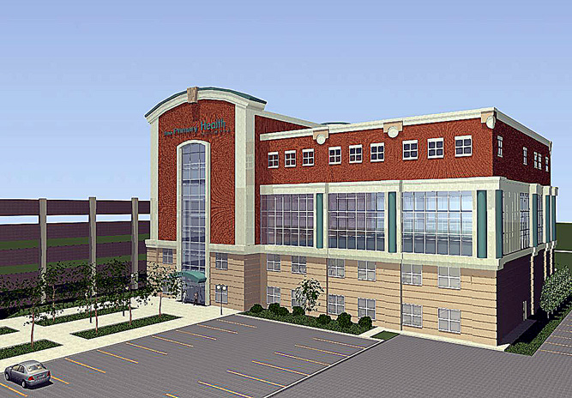
A Medical Office Building
For
The Primary Health Network
Sharon, Pennsylvania
Daniel Goff I Structural Option
Dr. Thomas Boothby l Faculty Advisor
Source: sharonherald.com
Source: primary-health.net

Slide 2
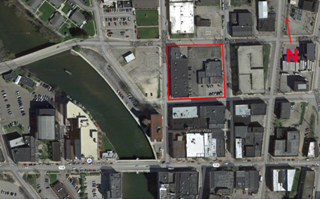
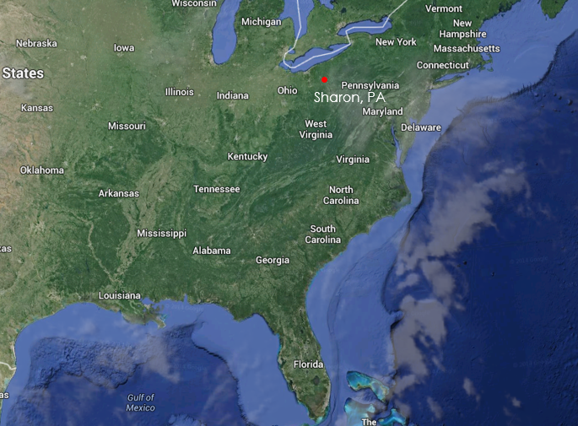
A Medical Office Building
Sharon, Pa
Building Introduction
Sharon, Pa
Building Introduction
Proposal
Gravity System Redesign
Slabs
Columns
Lateral System Redesign
Design
Assumptions
Architecture Breadth
Background
Façade
Conclusion
Acknowledgements
Architect John N. Gruitza Associates
Structural Engineer Taylor Structural Engineers
Construction Dates November 2014-January 2016
Height 79’-0”
Size 78,000 GSF
Primary Usage Medical Office Building

Slide 3
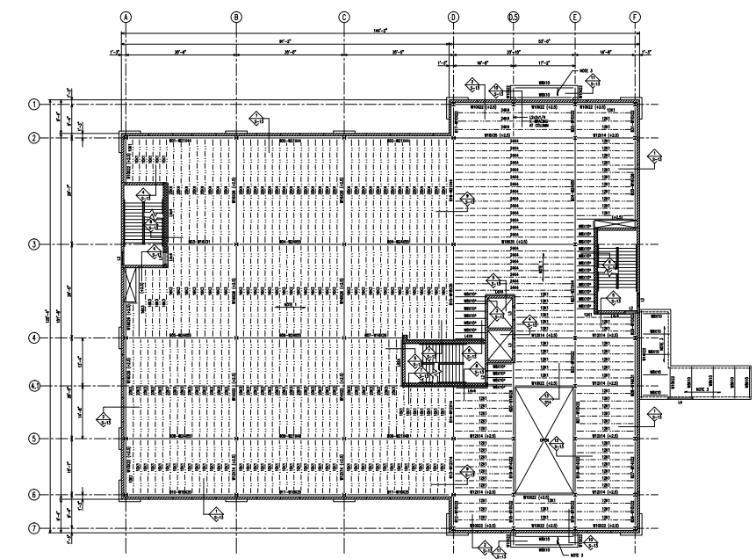
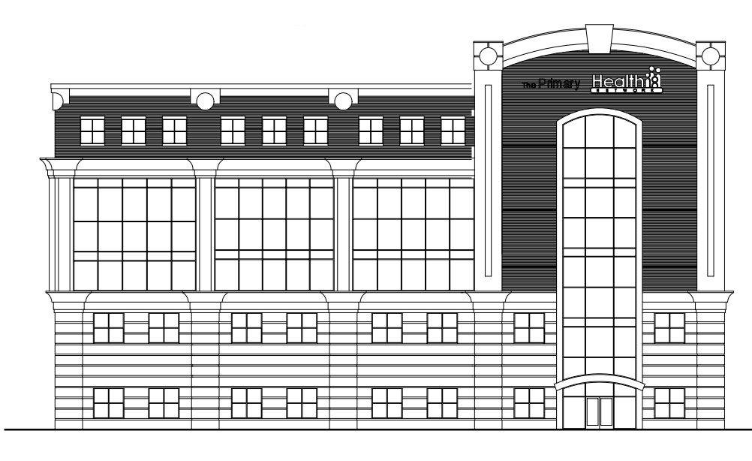
A Medical Office Building
Sharon, Pa
Building Geometry
Building Introduction
Proposal
Gravity System Redesign
Slabs
Columns
Lateral System Redesign
Design
Assumptions
Architecture Breadth
Background
Façade
Conclusion
Acknowledgements
2nd Floor Plan

Slide 4
A Medical Office Building
Sharon, Pa
Existing Gravity System
Building Introduction
Proposal
Gravity System Redesign
Slabs
Columns
Lateral System Redesign
Design
Assumptions
Architecture Breadth
Background
Façade
Conclusion
Acknowledgements
Spread Footings
Composite Floor deck
19/32” 26 gage form deck
K series Bar Joists
Wide Flange Members
Masonry Bearing Walls
2nd Floor Plan

Slide 5
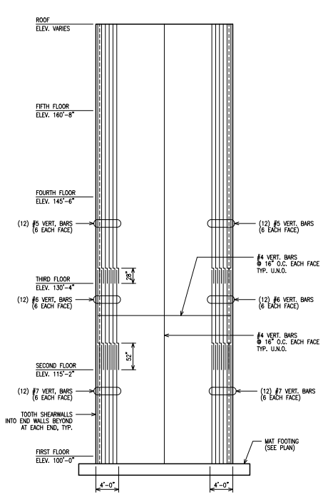
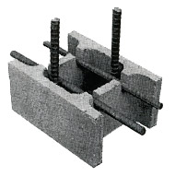
A Medical Office Building
Sharon, Pa
Existing Lateral System
Building Introduction
Proposal
Gravity System Redesign
Slabs
Columns
Lateral System Redesign
Design
Assumptions
Architecture Breadth
Background
Façade
Conclusion
Acknowledgements
Masonry Shear Walls
Load Bearing
Ivany Block
f’m = 3000psi
Source: koltcz.com
2nd Floor Plan

Slide 6
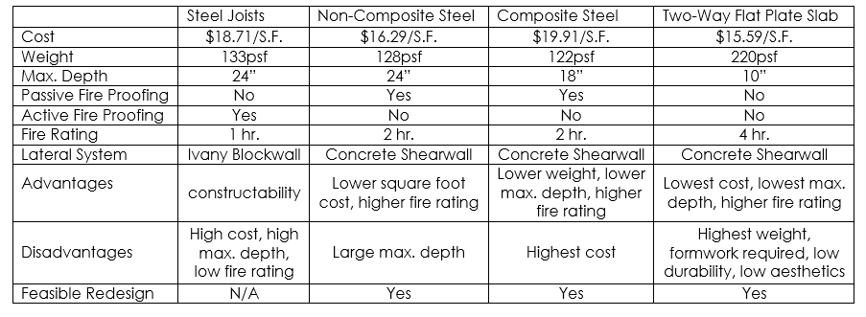
A Medical Office Building
Sharon, Pa
Investigated Designs
Decision Matrix
Building Introduction
Proposal
Gravity System Redesign
Slabs
Columns
Lateral System Redesign
Design
Assumptions
Architecture Breadth
Background
Façade
Conclusion
Acknowledgements
Non-Composite Beams
Composite Beams
Two-Way Flat Plate Slab

Slide 7
A Medical Office Building
Sharon, Pa
Proposed Alternate Solution
Goals
Building Introduction
Proposal
Gravity System Redesign
Slabs
Columns
Lateral System Redesign
Design
Assumptions
Architecture Breadth
Background
Façade
Conclusion
Acknowledgements
Gravity System
Two-Way Concrete flat Slab
Concrete Columns
Lateral
Concrete Shear Walls
No Change in Building Layout
Reduced Structural Depth
Reduced Cost

Slide 8
A Medical Office Building
Sharon, Pa
Proposed Alternate Solution
Goals
Building Introduction
Proposal
Gravity System Redesign
Slabs
Columns
Lateral System Redesign
Design
Assumptions
Architecture Breadth
Background
Façade
Conclusion
Acknowledgements
Architecture
Façade redesign
Construction Management
New Construction Timeline
Cost estimate and comparison
Modern aesthetics
Integrate with existing architecture
Reduced Cost
Feasibility of schedule

Slide 9
Gravity System Design
Lateral System Design
Architecture

Slide 10
Gravity System Design
Lateral System Design
Architecture

Slide 11
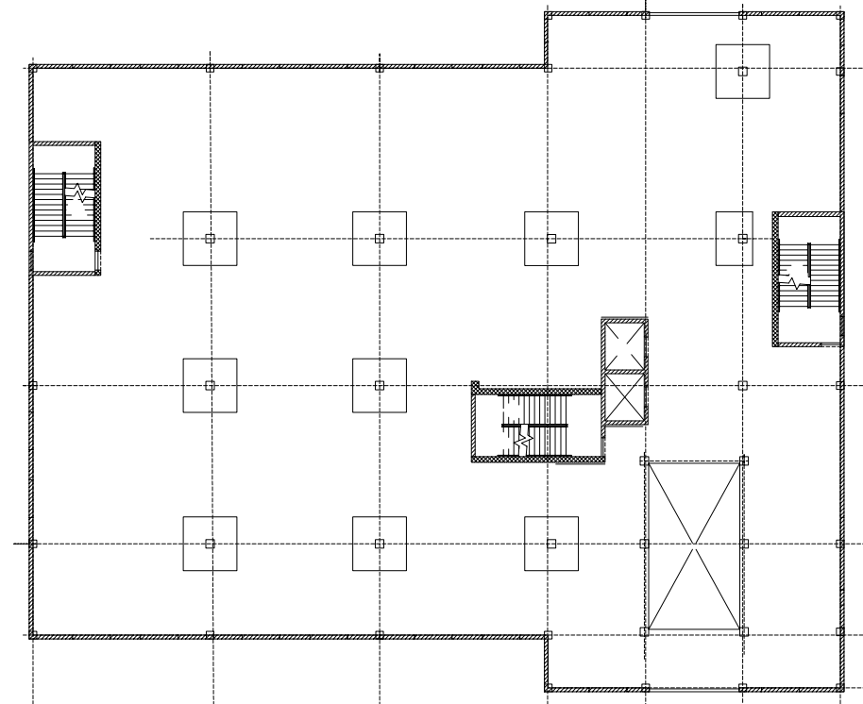
A Medical Office Building
Sharon, Pa
Slab Design
Design
Preliminary Design from CRSI
spSlab
Drop panels
Edge Beams
Constructability
Loading
Live load of 80psf
Superimposed Dead load of 20psf
Geometry
10” thick slab
9’ square drop panels
8” thick
18” square edge beams
Building Introduction
Proposal
Gravity System Redesign
Slabs
Columns
Lateral System Redesign
Design
Assumptions
Architecture Breadth
Background
Façade
Conclusion
Acknowledgements
Typical Floor Plan

Slide 12
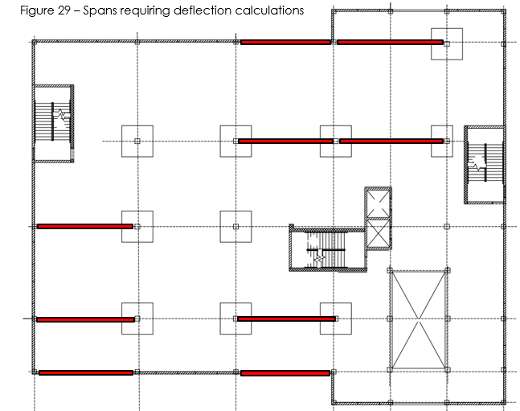
A Medical Office Building
Sharon, Pa
Deflections
Building Introduction
Proposal
Gravity System Redesign
Slabs
Columns
Lateral System Redesign
Design
Assumptions
Architecture Breadth
Background
Façade
Conclusion
Acknowledgements
ACI 318-11 Table 9.5(c)
10” 30’ span
ACI 318-11 Table 9.5(b)
l/360
l/240

Slide 13
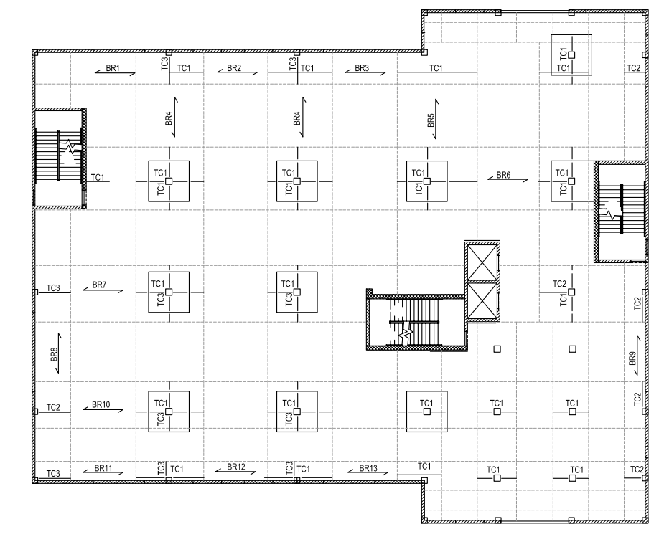
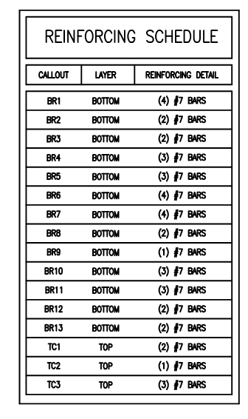
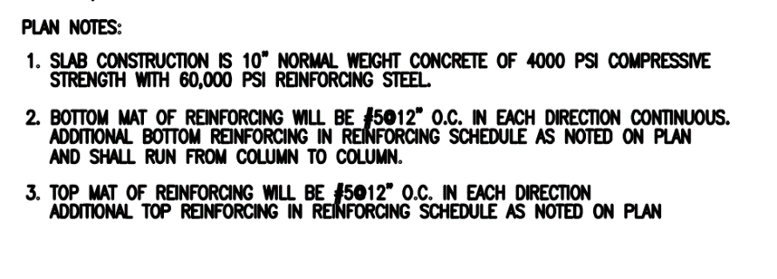
A Medical Office Building
Sharon, Pa
Building Introduction
Proposal
Gravity System Redesign
Slabs
Columns
Lateral System Redesign
Design
Assumptions
Architecture Breadth
Background
Façade
Conclusion
Acknowledgements

Slide 14
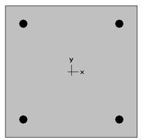
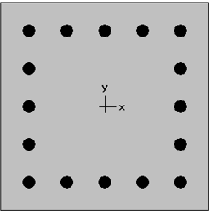
A Medical Office Building
Sharon, Pa
Column Design
Exterior Column
Interior Column
Building Introduction
Proposal
Gravity System Redesign
Slabs
Columns
Lateral System Redesign
Design
Assumptions
Architecture Breadth
Background
Façade
Conclusion
Acknowledgements
18”x18” Throughout
15’-6” Floor to Floor height
Four columns analyzed
spColumn
Two Designs selected
f’c = 4000psi
4 #9 Bars
16 #9 Bars

Slide 15
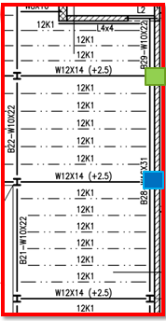
A Medical Office Building
Sharon, Pa
Column Locations
Building Introduction
Proposal
Gravity System Redesign
Slabs
Columns
Lateral System Redesign
Design
Assumptions
Architecture Breadth
Background
Façade
Conclusion
Acknowledgements

Slide 16
Gravity System Design
Lateral System Design
Architecture

Slide 17
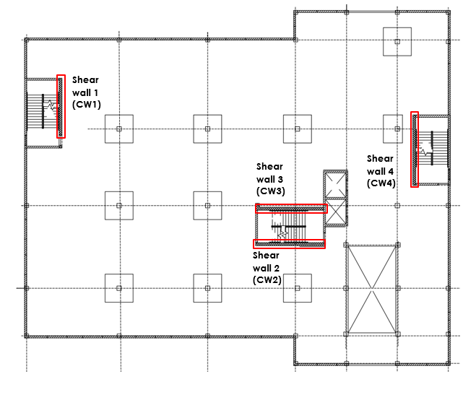
A Medical Office Building
Sharon, Pa
Shear Wall Design
Building Introduction
Proposal
Gravity System Redesign
Slabs
Columns
Lateral System Redesign
Design
Assumptions
Architecture Breadth
Background
Façade
Conclusion
Acknowledgements
Significant increase in building weight
Layout
ETABS 2013
f’c = 4000psi
12” Thick

Slide 18
A Medical Office Building
Sharon, Pa
Shear Wall Reinforcement Layout
Building Introduction
Proposal
Gravity System Redesign
Slabs
Columns
Lateral System Redesign
Design
Assumptions
Architecture Breadth
Background
Façade
Conclusion
Acknowledgements

Slide 19
A Medical Office Building
Sharon, Pa
Design Checks & Assumptions
Building Introduction
Proposal
Gravity System Redesign
Slabs
Columns
Lateral System Redesign
Design
Assumptions
Architecture Breadth
Background
Façade
Conclusion
Acknowledgements
P-Delta Effects
Out of Plane Stiffness
Drift Checks ∆ ≤ 0.23”
Non-Sway assumption
Rigid Diaphragm

Slide 20
Gravity System Design
Lateral System Design
Architecture

Slide 21
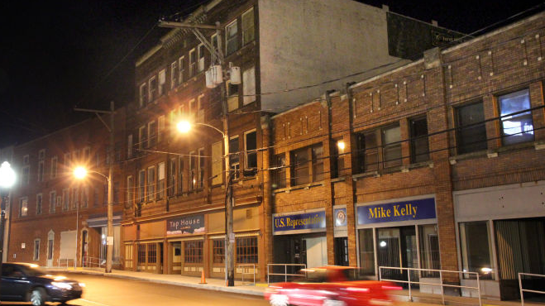
A Medical Office Building
Sharon, Pa
Background
Building Introduction
Proposal
Gravity System Redesign
Slabs
Columns
Lateral System Redesign
Design
Assumptions
Architecture Breadth
Background
Façade
Conclusion
Acknowledgements
First new project since 1969
Surrounding architecture
Existing façade
Source: sharonherald.com

Slide 22
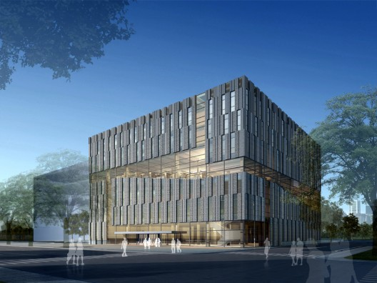
A Medical Office Building
Sharon, Pa
Case Studies
Tsinghua Law Library
Diana Center at Barnard College
Building Introduction
Proposal
Gravity System Redesign
Slabs
Columns
Lateral System Redesign
Design
Assumptions
Architecture Breadth
Background
Façade
Conclusion
Acknowledgements
Architect: KokaiStudios
Architect: Weiss/Manfredi
www.archdaily.com
www.flickr.com

Slide 23
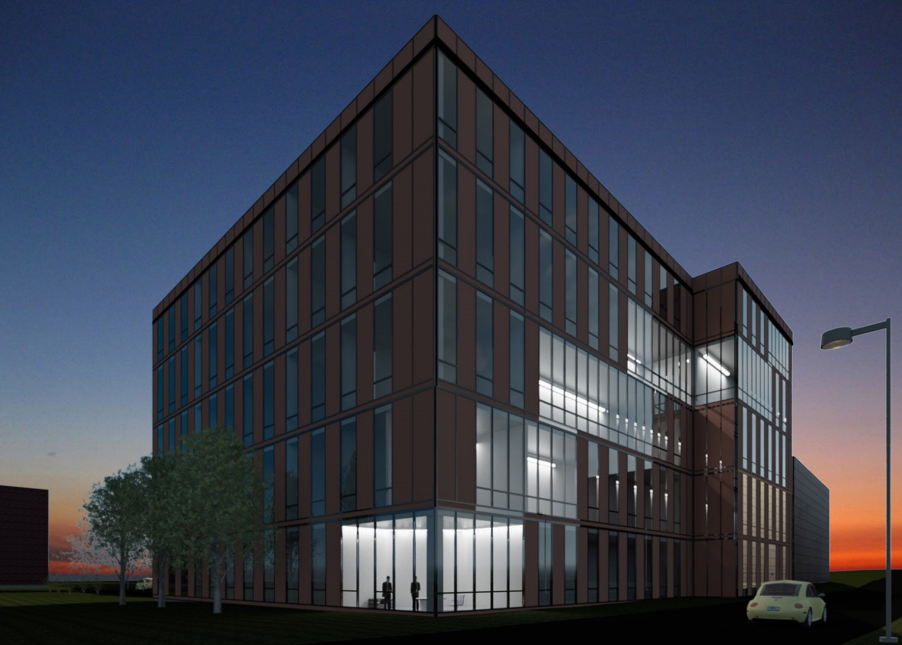
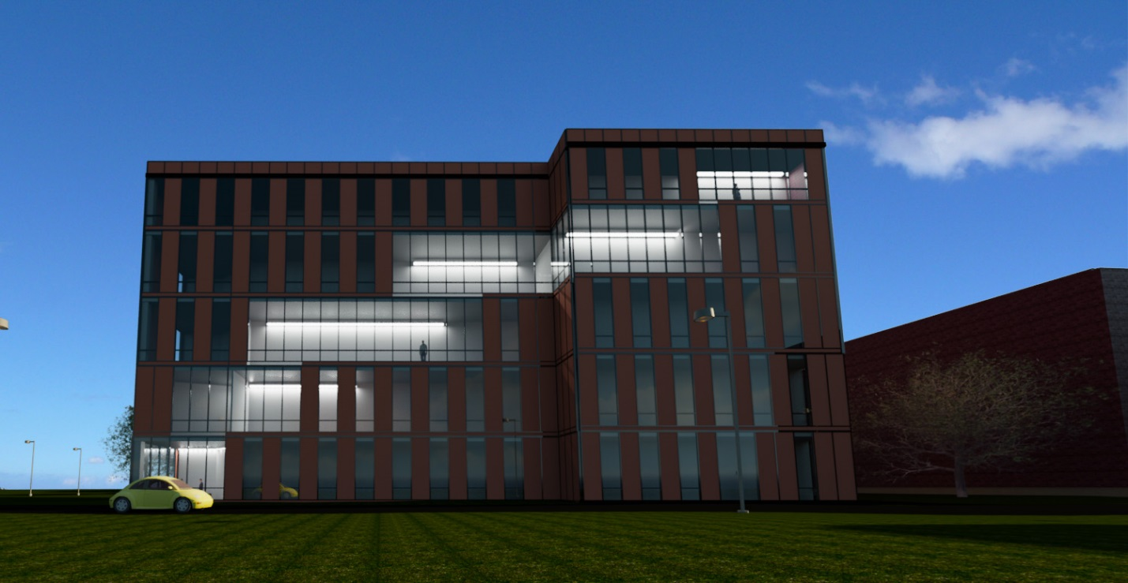
A Medical Office Building
Sharon, Pa
New Façade
North East View
North View
Building Introduction
Proposal
Gravity System Redesign
Slabs
Columns
Lateral System Redesign
Design
Assumptions
Architecture Breadth
Background
Façade
Conclusion
Acknowledgements

Slide 24
A Medical Office Building
Sharon, Pa
Conclusions
Building Introduction
Proposal
Gravity System Redesign
Slabs
Columns
Lateral System Redesign
Design
Assumptions
Architecture Breadth
Background
Façade
Conclusion
Acknowledgements
40% reduction in structural depth
Met all requirements for strength & serviceability
12% increase in structural cost
127% increase in façade cost
Structural Redesign: Viable Option
Façade Redesign: Not Feasible

Slide 25
A Medical Office Building
Sharon, Pa
Acknowledgements
Building Introduction
Proposal
Gravity System Redesign
Slabs
Columns
Lateral System Redesign
Design
Assumptions
Architecture Breadth
Background
Façade
Conclusion
Acknowledgements
Special Thanks to:
Thomas Boothby
Linda Hanagan
Taylor Structural Engineers
The AE Faculty
My friends and family

Slide 26
A Medical Office Building
Sharon, Pa
Building Introduction
Proposal
Gravity System Redesign
Slabs
Columns
Lateral System Redesign
Design
Assumptions
Architecture Breadth
Background
Façade
Conclusion
Acknowledgements
Questions

